Slide 1

Software Architecture Architecture Design Dr Roopak Sinha and Dr Quan Bai

Slide 2
Last Week
The need for software architecture
Stakeholders, viewpoints, views
Some architecture activities and characteristics

Slide 3
Outline
Principles of architecture design
Relationships between other development activities
Supporting activities
Functionality and quality attributes
Tactics for achieving quality attributes

Slide 4
Related Course Outcomes
Explain the factors and issues that come into play in the development of large-scale software systems.
Evaluate and discuss the properties of different software architectures.

Slide 5
What is design about?
Design: an activity of finding or creating solutions to problems given a set of obstacles to overcome
Fundamental to good design is a grasp of the problem being solved
Design without context is unpredictable and dangerous
Problem
Obstacles
Solution

Slide 6
Design principles
Principles of successful architecture definition:
Encourage effective communication of architectural decisions, principles and the solution itself to stakeholders
Pragmatic (consider real-world issues)
Flexible (technology-neutral, do not stick on particular tools, frameworks…)
Ensure the architectural decisions and principles are adhered to throughout the lifecycle up to the final deployment
Structured (clear definition of objectives, inputs and outputs of each steps)

Slide 7
Architecture design and other process activities
Requirements analysis, architecture design and software construction have a strong, interconnected set of relationships
Requirements analysis provides an initial context for architecture design but is then itself affected by architecture design as requirements are understood more fully
Architecture design drives the implementation process, but each piece of construction performed provides feedback about the effectiveness and utility of the architecture use
Requirement analysis
Problem
Design
Solution
Construction

Slide 8
General
Specification
Design
Level of detail
Requirements
Architecture
Construction
Detailed

Slide 9
Supporting activities for architecture design
Before the architecture design process, the following will be available and accepted by the sponsor:
A definition of the system’s baseline scope and context
A definition of key stakeholder concerns

Slide 10
Define Initial Scope & Context
Outputs
Inputs
Engage stakeholders
Functionality & quality attributes
Stakeholder concerns
Capture first-cut concerns
Guidelines & constraints
Architecture design
Scope & context
System construction
Architectural model & description

Slide 11
Functionality and quality attributes
Again, why do we need architecture?
To help use to develop a high quality software product
Does quality really matter for software product?
Ariane 5
Reason of the failure: … The Operand Error occurred due to an unexpected high value of an internal alignment function result called BH, Horizontal Bias, related to the horizontal velocity sensed by the platform. This value is calculated as an indicator for alignment precision over time. The value of BH was much higher than expected because the early part of the trajectory of Ariane 5 differs from that of Ariane 4 and results in considerably higher horizontal velocity values…

Slide 12

Ariane Explosion

Slide 13


Software quality is very important!
Software products are not like other products
It’s easier to make mistakes in producing software products or ignore the quality
The results can be more serious
No physical limit
No existing examples or guide
There is a physical limit
Plenty of existing examples

Slide 14
GOOD = ?
Customer are satisfied with the product
Deliver what they want (functionality)
Reliable, easy to use, …
The organisation can gain benefits
…
What should be considered throughout architecture design?
Quality attributes

Slide 15
Availability
Modifiability
Performance
…
Usability
Security
Testability
Quality attributes (QAs):
Availability: is concerned with system failure and its associated consequences

Slide 16
Discussion
Which quality attributes are most important for your project?
How can you capture these attributes at the architecture-level?

Slide 17
Modifiability: cost of change
Which part can be changed (the artefact)
When is the change made and who makes it (the environment)
Performance: timing
Respond time when events happen
How many events can be handled at the same time?
Examples:
Web-based financial system:
Event=online transactions

Slide 18
Security: the ability of the system to prevent or resist unauthorized access while providing access to legitimate users.
Testability: the ease with which the software can be made to demonstrate its faults or lack thereof.
To be testable the system must control inputs and be able to observe outputs.

Slide 19
Usability: how easy it is for the user to accomplish tasks and what support the system provides for the user to accomplish this
Learning system features
Using the system efficiently
Minimizing the impact of errors
Adapting the system to the user’s needs
Increasing confidence and satisfaction
Easy to use
Easy to learn

Slide 20
Some other things you also need to consider
Business qualities:
Time to market
Cost and benefit
Lifetime of the system
Targeted market
Integration with legacy system
Rollout schedule

Slide 21
Are these attributes really important??

Slide 22

Example

Slide 23

These attributes are related to each other
Security
Availability
Usability
Would you think this is usable?
Performance
Modifiability
Testability
Why?
If a system is modifiable, it can also
has higher availability
Performance and availability will affect usability
Testability can enhance performance, availability, usability,…
…

Slide 24
QAs in development process
Every stage in development process further constrains space for QAs
Architecture is on top level and thus most critical
QAs are achieved only by combination of: architecture (big picture) and non-architectural (details) choices, e.g.:
QA | Architectural level | Implementation level
Usability | Redo/undo support | GUI components, layout, GUI coding
Modifiability | Independent modules | Design patterns, program structure, coding, etc.
Performance | Resources allocations, interaction protocols, communication infrastructure | Algorithm design, optimization techniques, etc.

Slide 25
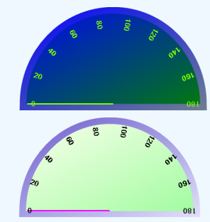

Understanding quality attributes
Quality attribute scenarios (specifying requirements):
Involve stakeholders to simulate different scenarios
Each scenario will focus on one particular quality attribute
Goal: specify required outputs for a particular relevant situation
System
Stimulus
Response
Source:
stakeholders who concern about the attribute
Environment
Required outputs:
Response
Response measure
Inputs:
Stimulus
Source of stimulus
Preconditions:
Environment of the scenario (state of system)
Resources (artifacts) that are subject of the QA

Slide 26
Tactics for achieving quality
Tactic: a design decision that influences the control of a quality attribute response
A collection of tactics is called an architectural strategy
Architectural strategy
Availability tactics
Modifiability tactics
Performance tactics
Testability tactics
Usability tactics

Slide 27
Improving availability
Some notions:
Mistakes: A human action that produces an incorrect result
Fault: cause of a mistake. An incorrect step, process or data definition in computer system. Fault types:
transient: exists and then disappears
intermittent: repeatedly; disappears in between
permanent: remains until repair
Faults can occur for all system components
Failure: An incorrect result. The result of the fault.
Mistake
Fault
Failure

Slide 28
Availability is concerned with system’s failure to provide specified services.
failure is observable by the service user (another system or human operator)
Availability definition:
Fault tolerant: continue to provide required or degraded service despite the presence of faults
Mean time to failure
Availability =
Mean time to failure + Mean time to repair

Slide 29
Availability - QA scenarios example
Source
System external / system internal (other subsystem)
Stimulus
Fault: in external input, failure in subsystem, e.g. omission / crash /timing error / wrong input
Exception raised when fault is detected
State of system (environment)
Normal / degraded operation, overloaded system
Affected resources (artifacts)
Process, processor, storage, communication… or entire system
Response & tactics
log, notify, disable, continue (normal/degraded), replicate, ...
Response measure
Repair time, availability, available/degraded time interval...

Slide 30
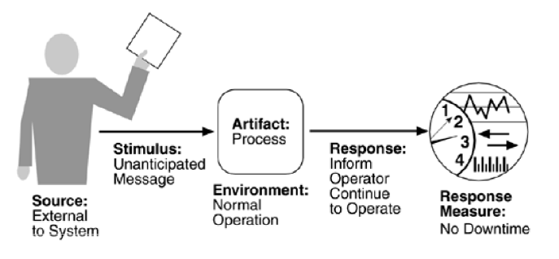
Inputs:
Stimulus: unanticipated message
Source: external
Required outputs:
Response: continue
Response measure: no downtime
Preconditions:
State of system: normal operation
Affected resource: process that handles messages

Slide 31
Availability tactics- QA tactics example
Voting: processes running on redundant processors each take equivalent input and generate an output value that is sent to a voter. If the voter detects deviant behaviour from a single processor, it fails it.
If the processors are using the same algorithm, only processor faults can be detected
If different algorithms are applied in different processors, the faults can be from the processor or/and the algorithm
log(x)=?
1, -6, 10
Processor 1
0, invalid, 1
voter
1, -6, 10
Processor 2
0, 0.78, 1
0, invalid, 1
1, -6, 10
Processor N
0, invalid, 1
Can be used for both fault detection & recovery
Has no down time
Expensive to develop and maintain
Used for control systems

Slide 32

Redundancy: include redundant components respond to events
Active redundancy: respond to events in parallel
Passive redundancy: One primary component responds to events and informs the other standbys of state updates they must make
Also no downtime
Expensive
Active redundancy
Passive redundancy
Processor 1
Processor 2
Processor 1
Processor 2

Slide 33

Spare: a standby spare computing platform for different failed components
Needs reboot and re-configuration
Has down time, but much cheaper

Slide 34
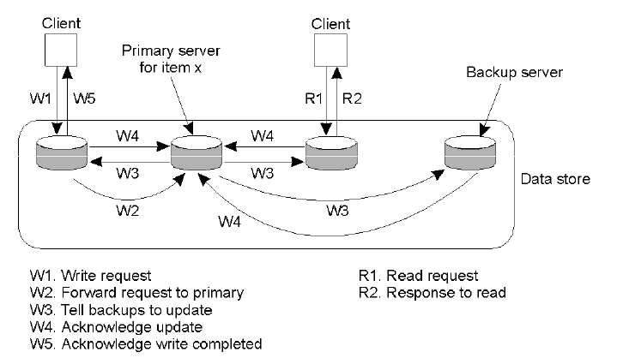
Example: Primary backup

Slide 35
Improving modifiability
Modifiability is concerned with the cost of system change....
Affected by the responsibilities and relationships of system modules
Also affected by the time and effort to do modification:
Modification done by developer requires testing and distribution process
Time lag between making change and making it available to the user
Allow late change or even non-developers to make changes

Slide 36
Modifiability - QA scenario example
Source
End user / developer / operator
Stimulus
Change request concerning function / quality / capacity
State of system (environment)
During analysis / at design time / implementation time, …
Affected resources (artifacts)
Functionality / platform / user interface / environment…
Response & tactics
Normal design sequence of specify, change, test, deploy
Limit dependencies, select appropriate styles
Response measure
All response activities cost time and money which can be measured (manpower spec e.g. 3 man-years )...

Slide 37
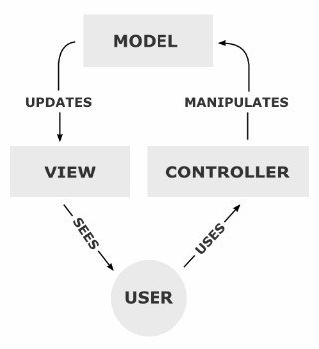
Modifiability tactics
Using MVC model:
Model: represents data and the rules that govern access to and updates of this data.
View: renders the contents of a model. It specifies exactly how the model data should be presented. If the model data changes, the view must update its presentation as needed.
Controller: translates the user's interactions with the view into actions that the model will perform.

Slide 38
Performance tactics
Performance contributors:
Resources:
CPU, data stores, network bandwidth and memory
Entities defined by system design, e.g., sequential buffer management, information/data flow
Blocked time: a computation can be blocked from using a resources because:
Availability of resources
Dependency on other computation

Slide 39
Performance tactics:
Increase available resources: faster processors, additional processors, additional memory, faster networks…
Introduce concurrency
Maintain multiple copies of data
Task division and scheduling

Slide 40
Sample exam question
What is ____ility? How can you capture it using architecture design?
Describe 3 QAs and justify why these are very important for a given system.

Slide 41
Readings
Shaw, Mary, and Paul Clements. "The golden age of software architecture."Software, IEEE 23.2 (2006): 31-39.
Svahnberg, Mikael, et al. "A method for understanding quality attributes in software architecture structures." Proceedings of the 14th international conference on Software engineering and knowledge engineering. ACM, 2002.

Slide 42
Readings
O'Brien, Liam, Paulo Merson, and Len Bass. "Quality attributes for service-oriented architectures." Proceedings of the international Workshop on Systems Development in SOA Environments. IEEE Computer Society, 2007.

Slide 43
Homework
Finish the readings.
Complete your proposal – due next week!

Slide 44
Questions?

